Slide 1
AI in Procurement: Upskilling People and Capabilities

Slide 4





YOUR SPEAKERS
Mat Langley
SPP Emerging Technology
Chapter Co-Chair
Vinitha Matthew
Responsible Sourcing Lead
Novonesis
CK Lin
Principal Consultant
eZ Solutions

Slide 5
Agenda
01 | Emerging technology of backbones and orchestration layers and how emission data will be leveraged
02 | AI solutions as the new enabler for Procurement Sustainability
03 | Program Governance Framework and the required adaption for AI solutions
04 | Q&A
05 | Key Takeaways

Slide 6
01. The procurement team of the future
Humans orchestrate the strategy. AI performs the workload.
Market scanning
Contract intelligence
Commodity shifts, tariffs,
climate events, geopolitical signals
Clause extraction, gap
analysis, compliance review, Q&A
The conductor
Strategy
Relationships
Governance
Innovation
Supplier intelligence
Category research
ESG scoring, risk signals,
adverse media, maturity tracking
Trends, benchmarks, carbon
hotspots, peer analysis
Sourcing execution
Spend analytics
Scope 3 data
Reporting & comms
RFx drafting, evaluation,
short-listing, scenario modelling
Patterns, leakage, demand
signals, validation
Collection, validation,
PCF exchange
Dashboards, supplier letters,
campaign tracking, board packs
AI takes the sensing, drafting and checking. People steer policy, exceptions and supplier outcomes.
Notes:
[Sources]
- Content structure and labels adapted from the user-provided concept image: /mnt/data/556968de-ec53-4371-971e-36378d6ffa74.png
- Branding assets reused from the user-provided working deck: /mnt/data/WSPD_AI_Procurement_Opening_Slides.pptx (extracted media image-1-1.png and image-1-2.png)
- Narrative language synthesised from the user brief in this chat.

Slide 7
02. The emerging procurement tech stack
Four layers powering sustainable procurement — backbone alone won’t get you there.
4
Orchestration layer
Intake, workflow routing, approvals, policy enforcement — the new battleground.
AI copilots
span all layers
ORO Labs
Zip
Omnea
Tonkean
3
Data layer
Decision-grade intelligence — emissions, risk, ESG and market signals.
Carbon / PCF
Adverse media
ESG ratings
PACT / Pathfinder
Commodity forecasts
2
Best of breed
Specialist depth where S2P platforms fall short — supplier engagement, carbon and risk.
Green Project
EcoVadis
M2030
Watershed
IntegrityNext
1
Backbone — source to pay
Transactional core: requisitions, POs, invoices and contracts — necessary but not sufficient.
SAP Ariba
Coupa
GEP
Jaggaer
Ivalua
The winning architecture is not one monolith. It is a governed stack.
Notes:
[Sources]
- Content structure adapted from the user-provided concept image: /mnt/data/adee0f34-c79b-47f2-91c4-5b3c85914f3b.png
- Vendor examples and layer definitions synthesised from the user brief in this chat.
- Branding assets reused from the user-provided working deck: /mnt/data/WSPD_AI_Procurement_Opening_Slides.pptx (extracted media image-1-1.png and image-1-2.png).

Slide 8








03. Get ready: AI for me first, process redesign next
Start with personal AI use. Then partial or full process replacement becomes a smaller change-management move.
Step 1 — AI as a tool
Step 2 — AI in the process
What to change now
Build habit and trust by helping people with the work they already own.
Partial or full process substitution feels incremental once AI is already normal in the day job.
• get every category / sourcing role using AI weekly
• redesign workflows before automating them
• clean data, policies and permissions
• train judgment, supplier engagement and exceptions
Intake
Ari
Cara
Category
Manager
Route to agent
Policy / risk check
This is how “AI for me” becomes “AI runs part of
the work”.
Research
Copilot
Analyst
Human approval
Task-focused copilots and agents for the
work people do today.
Execute + learn
Start with the person, not the process
Then scale into workflow and operating model
Adoption sticks when people experience value themselves first
First: AI for me. Then: AI runs part or all of the workflow.
Notes:
[Sources]
- Slide narrative adapted from the user brief in this chat and from the prior working deck /mnt/data/WSPD_AI_Procurement_Opening_Slides.pptx.
- Branding, photo and icon assets reused from the extracted media files in /mnt/data/extract_current/ppt/media (image-1-1.png, image-1-2.png, image-3-3.jpg, image-3-4.png to image-3-10.jpg).

Slide 9

02. AI solutions as the new enabler for Procurement Sustainability
Vinitha Mathew

Slide 10





Why AI matters in Procurement Sustainability
With AI, sustainable procurement becomes the competitive advantage that compounds daily.
Data- overload and gaps
Low engagement rates
Manual or slow process
Regulatory pressures and company commitments

Slide 11
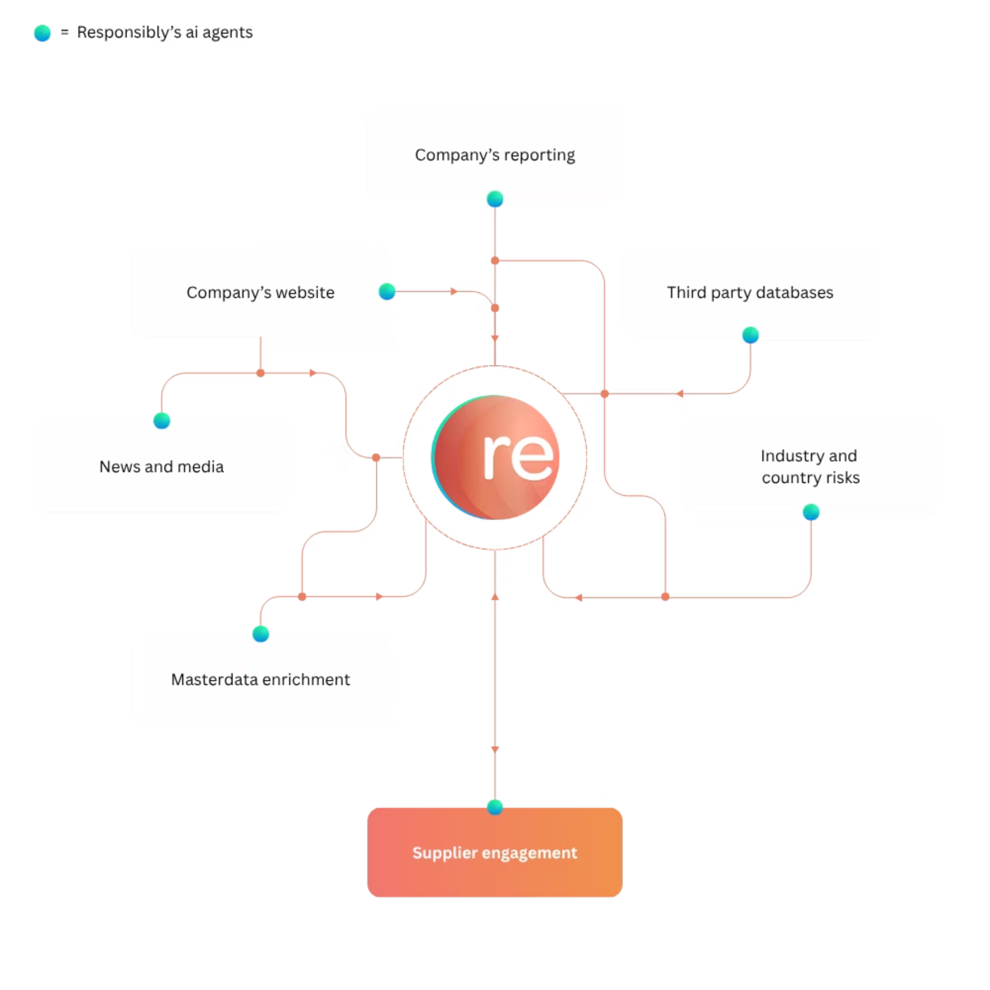
Case 1: Achieve Supply chain sustainability at scale with fewer resources
Intelligent Vendor Management: Real-time ESG scoring
Proactive Risk Mitigation: Early warning risk signals
Regulatory Compliance: Alignment with supply chain regulations
Practical Sustainability: ESG embedded in buyer/ category manager workflows
Notes:
Basic Vendor Scoring: limited criteria
Manual due diligence process
Reactive Compliance Monitoring: based on thresholds
Intelligent Vendor Management: Real‑time ESG scoring to support informed sourcing decisions Proactive Risk Mitigation: Early identification and management of risks based on leading indicators Regulatory Compliance: Ongoing alignment with applicable ESG and supply‑chain legislation Embedded Sustainability: Practical, hands‑on ESG insights integrated into daily workflows for category managers and buyers
AI augments procurement, not replaces it—so teams must shift from transactional execution to insight-driven, strategic roles.

Slide 12




Significantly reduce the workload of both companies and suppliers while increasing intelligence
Master Data
Context & Risk
Online Footprint
Actions
Third Party Sources
News and Media
Engagement
Response evaluation
Translations
Analysis
Prioritization
Document Review
Notes:
Master Data: Entity resolution & data, Find past names, parents. Online footprint: Find websites, Context and risk
Find industries, locations

Slide 13
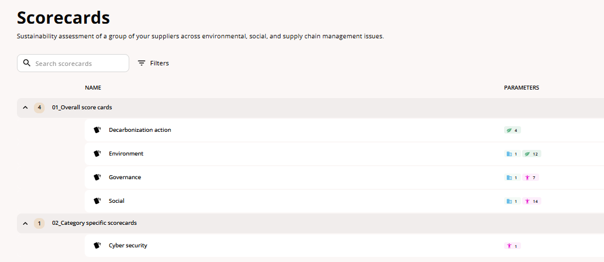
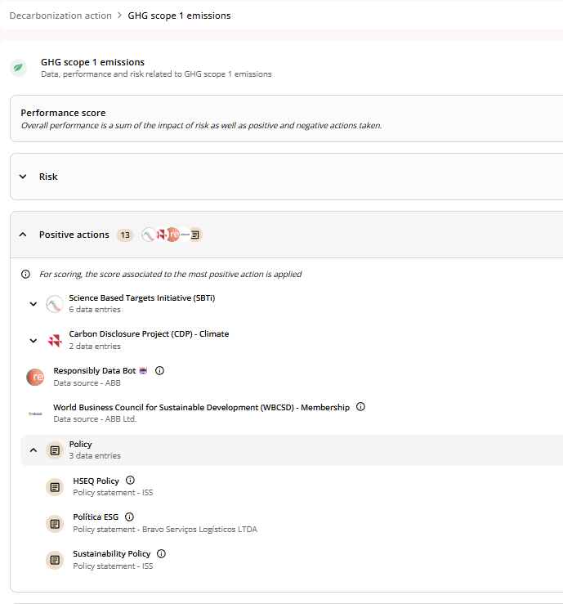
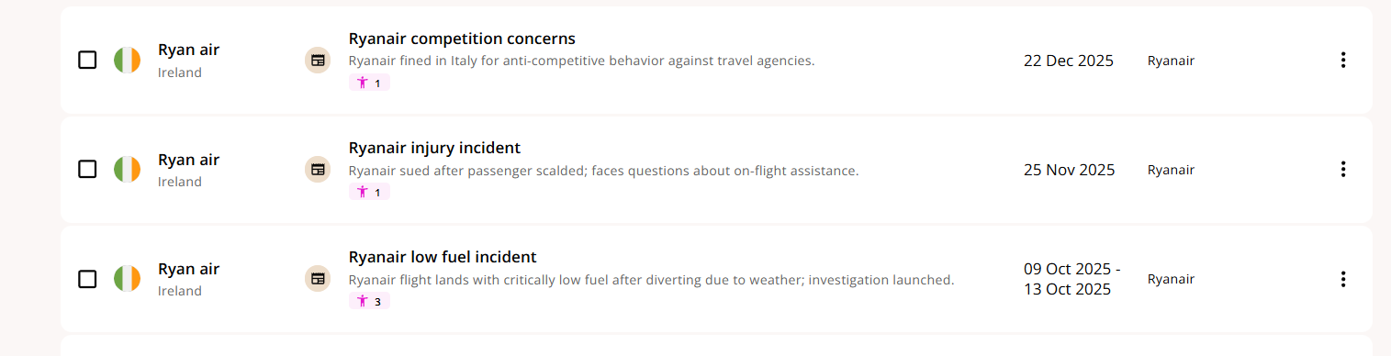
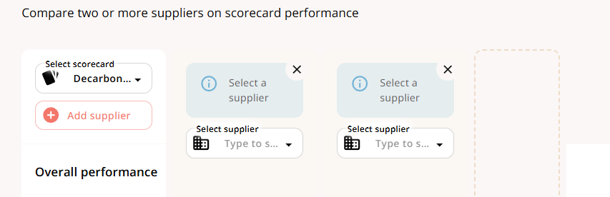
Customized Scorecards
Incident Management
Tender Input
Notes:
1. Customizable ratings to fit your needs
Rich details behind scores; navigate down to the raw data to build credibility
Any information, positive or negative, automatically gets analyzed and contributes to the performance profile of the supplier

Slide 14
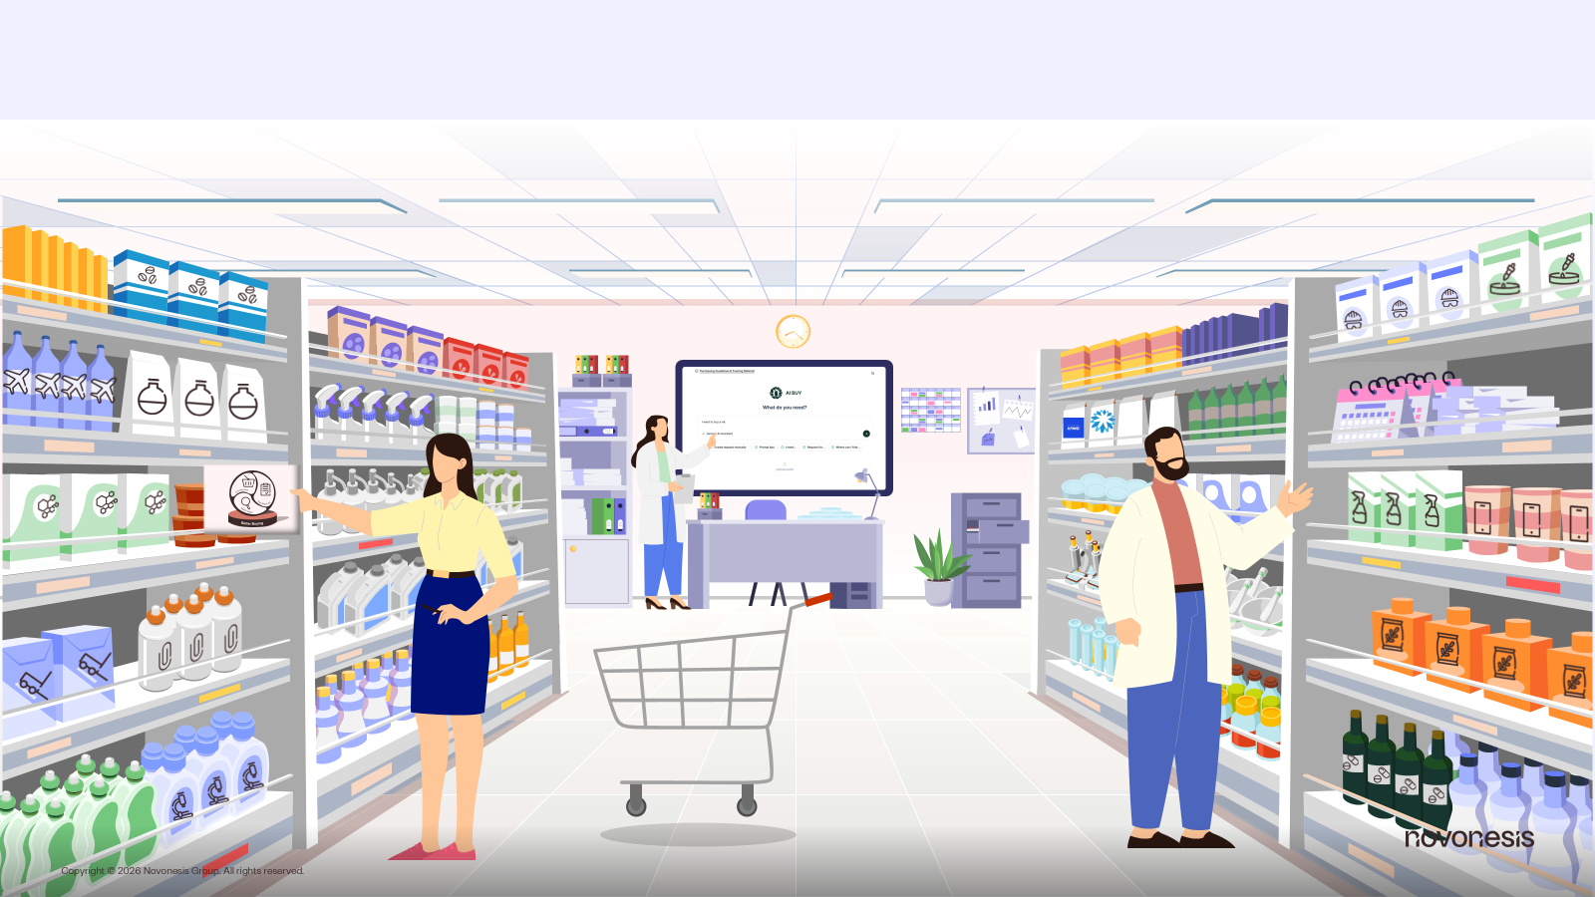
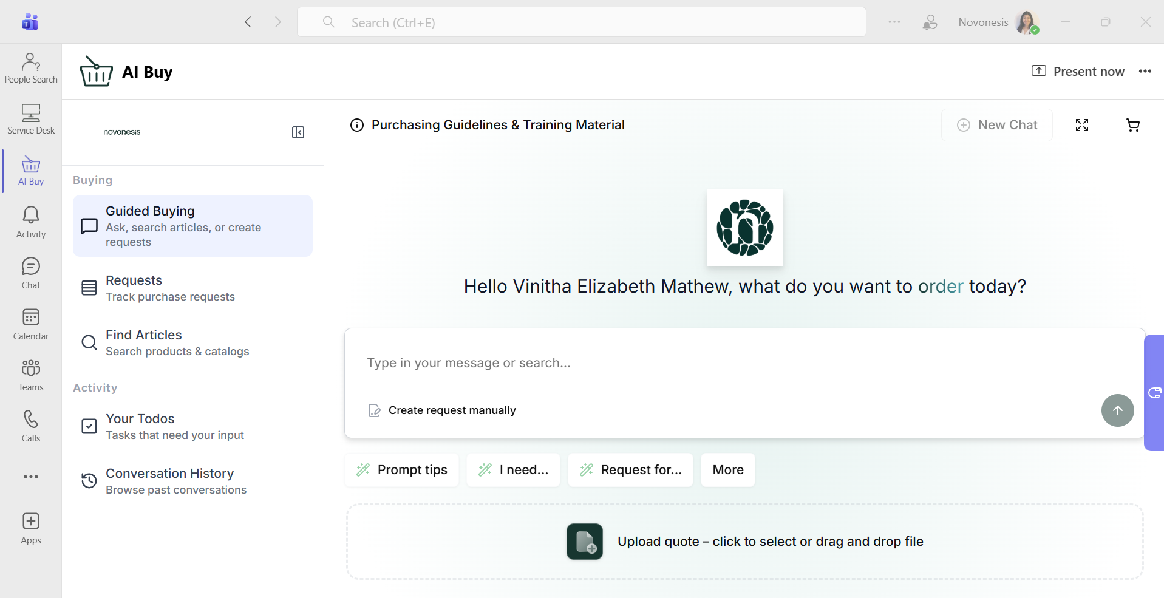
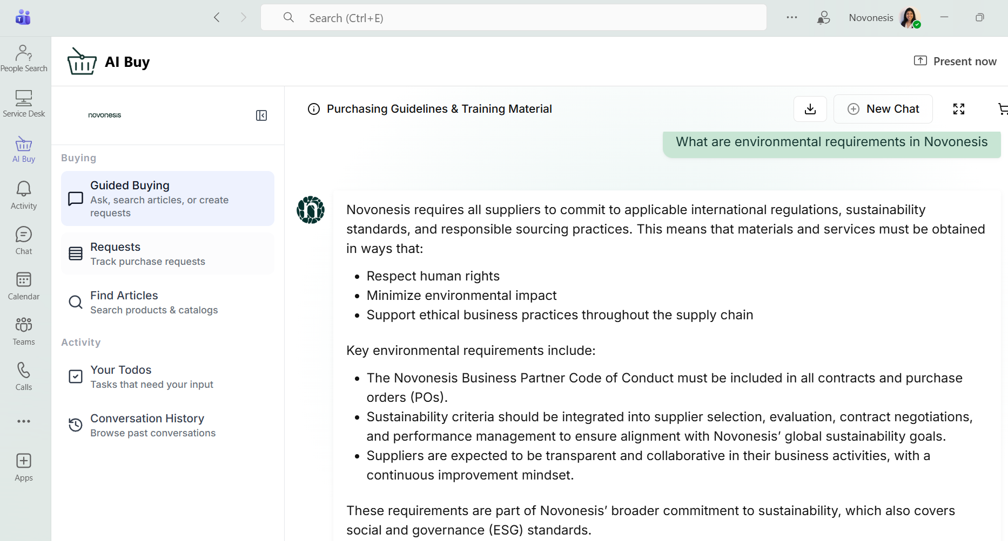

Case 2: Effortless, compliant procurement
Easy Access
Spend Sustainable
Support Compliance
Notes:
Cost Effiiciency, Spend Sustainable, EasyAccess via Teams, User friendly, Support Compliance
Eco label searches possible

Slide 15
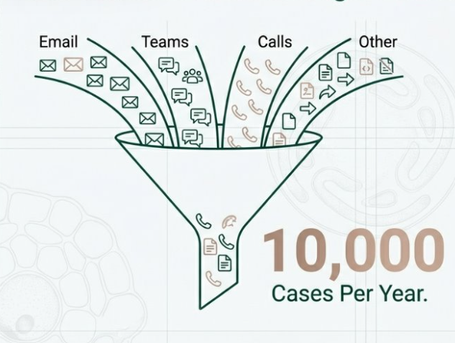



Case 3: Driving efficiency by streamlining requests
Agent
Request
Report
Trigger
Databases
Notes:
Increased Process Quality, Consistency
Move focus of procurement employees from data retrieval to value creation
Call out to the Indirect- team softwares, cleaning products etc.

Slide 16
Upskilling of People and Capabilities in the wake of AI
Program Governance Framework and its adaptation for managing AI

Slide 17
Digital Transformation – Back to Basics
Digitization - the process of changing from analogue to digital form … without any different-in-kind changes to the process itself (Gartner Glossary)
Digitalization - use of digital technologies to change a business model … it is the process of moving to a digital business (Gartner Glossary)
Digital transformation
Vision & objectives
Digital maturity
Digital strategy & roadmap
Select, implem’t, change mgmt
Measure, monitor, optimize
3 – 4 months
4 – 10 months
1 – 7 years
→ How ?

Slide 18
Program Governance Framework
3 Components of the Framework
➢ Stakeholder Map and RSI Matrix
➢ Program Roadmap
➢ Governance Documentation

Slide 19
Stakeholder Map
Requestor
Financial
Approver
Commodity
Approver
Buyer
Support Functions
Procurement
Business User
Company (internal)
External
Category
Manager
Finance
& Acct.
Proc.
Support
App. X
IT / Tech.
Vendors
Group
Sustainability
Integ.
vendors
Sys.
prov.
Transact.
vendors
S.I.

Slide 20
RSI Matrix – Supplement to Stakeholder Map
Stakeholder | Responsible | Support | Informed
Requestor | • Raise PR to initiate purchase • Receive and acknowledge receipt via Receipt (GRN) • Specify and describe the required goods/services sufficiently to enable Procurement to conduct tactical sourcing • Select the most suitable vendor presented by Procurement following a sourcing event • Secure quotations from vendors for one-time and low-value purchases | • Approval of PR by Financial Approver • Clarify queries from vendors on the specification and requirement of goods/services | • Status of PR approval • PO placed by App. X
Financial Approver | • Approve/Reject requests for purchases based on business needs (fit, timing, budget, etc.) | TBD | • Status of PR and PO
Commodity Approver | • Approve/Reject PR based on fit to company’s technical standard for the commodity | TBD | TBD

Slide 21
Program Roadmap – Core of the PGF
Design
Plan, Organize
Build
Acquire, Implement
Run
Deliver, Support
• Application roadmap
• Intended business process
• BRS / CR process
• Central / Joint governance
• Level 0 Process map
• Change communication
• Business test management
• System & content languages
• User manuals & guides
• Data ownership
• Training approach
• Support model
• User & master data management
• Production-Test instances
Measure, Monitor & Optimize
• Users’ survey & feedback
• Knowledge exchange
• Budget management
• Stakeholder Map & RSI matrix
• Risk management & BCP
• Integration management
• Support tickets analysis

Slide 22
Program Roadmap – Adapted for AI
Design
Plan, Organize
Build
Acquire, Implement
Run
Deliver, Support
• Application roadmap
• Business objectives / processes
• BRS / CR process
• Central / Joint governance
• ‘Golden’ questions
• Model parameters
• Training data
• LM ownership
• Support process (minimal)
Measure, Monitor & Optimize
• Users’ feedback
• Budget management
• Adjust Model parameters
• Loss function
• Stakeholder Map & RSI matrix
• Risk management & BCP
• Support tickets analysis

Slide 23
Caveat for AI adoption - Moderation
• Global data centre industry to emit 2.5 billion tons of CO2 through 2030
- Morgan Stanley, 2024
• Data centres already accounted for 1% to 1.5% of global electricity consumption
- International Energy Agency, 2022
• By 2030, it is thought that 13% of the world’s electricity consumption will be attributed to data centres
• Real emissions are probably 7.62 times higher than officially reported (by tech firms)
• The average web page produces approximately 0.36g CO2 per pageview
- https://www.websitecarbon.com/

Slide 24
YOUR SPEAKERS
Mat Langley
SPP Emerging Technology
Chapter Co-Chair
Vinitha Matthew
Responsible Sourcing Lead
Novonesis
CK Lin
Principal Consultant
eZ Solutions

Slide 25


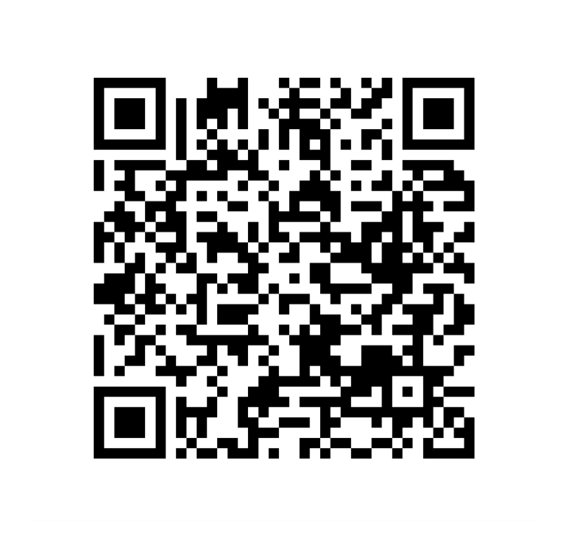
Sign the pledge!
Activate your power
#ProcureTomorrow

