Slide 1

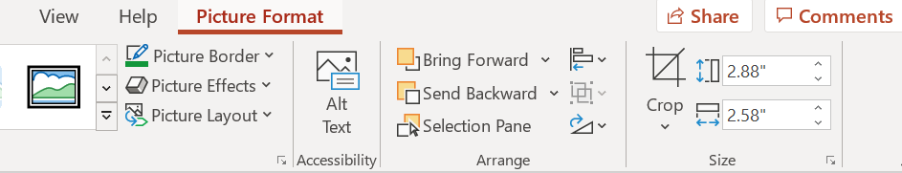
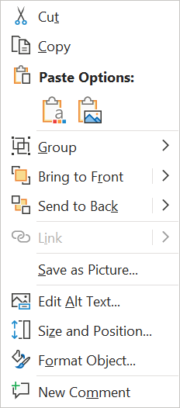
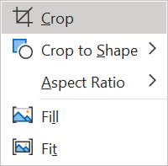


Quick Guide: Adding the Sustainable Procurement Pledge
Ambassador Banner to your LinkedIn Profile Picture
Insert your profile image into the placeholder on the right →
Crop the image according to the size of the placeholder by right-clicking on the picture and selecting Crop
Remove the example picture and place your picture in the template.
1
2
3
4
Select your picture + the ambassador bottom, then right click while both elements are selected, and save it as a picture.
Use the new picture in your LinkedIn profile.

